Slide 1

FLIGHT DELAY ANALYSIS
BY GROUP 1

Slide 2
Flight delay analysis
Introduction
KPI’s
Analysis
Conclusion
Members

Slide 3
Team Members
Nithin K J
Sakshi Prashant Bargaje
Swaroop Charles Lankapalli
Yashika Agrawal
Rupali Krushnaji Babhare
Rupal Raju Meshram
Sumanth Guha
Sujata Badaik
Mentor :
Shubham Kabre Sir

Slide 4
INTRODUCTION
Flight delay is inevitable and it plays an important role in both profits and loss of the airlines.
An accurate estimation of flight delay is critical for airlines because the results can be applied to increase customer satisfaction and incomes of airline.
Predicting flight delays can improve airline operations and passenger satisfaction, which will result in a positive impact on the economy.
It allows companies to have the capability to decide on the strategic allocation of resources, decide the need for corrective actions, or to adjust current strategies to reflect new situations.

Slide 5
KPI’s
Week wise , state wise and city wise statistics of delay of flights with airline details
Number of airlines with no departure/ arrival delay with distance covered between 2500 and 3000
Total number of cancelled flights for jet blue Airways on first date of every month
Weekday vs Weekend total flights statistics

Slide 6
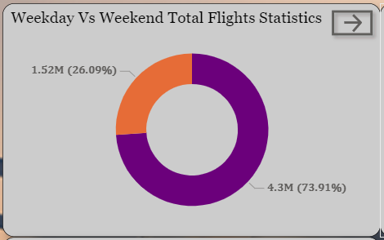
Weekday vs Weekend total flights statistics
Compared to weekday and weekend flights statistics we can see that more flights run on weekends.

Slide 7

Total number of cancelled flights for jet blue Airways
The highest number of cancellations on first day in the month of June which is 55 followed by Feb i.e 42 and the least that is 1 in Jan.

Slide 8
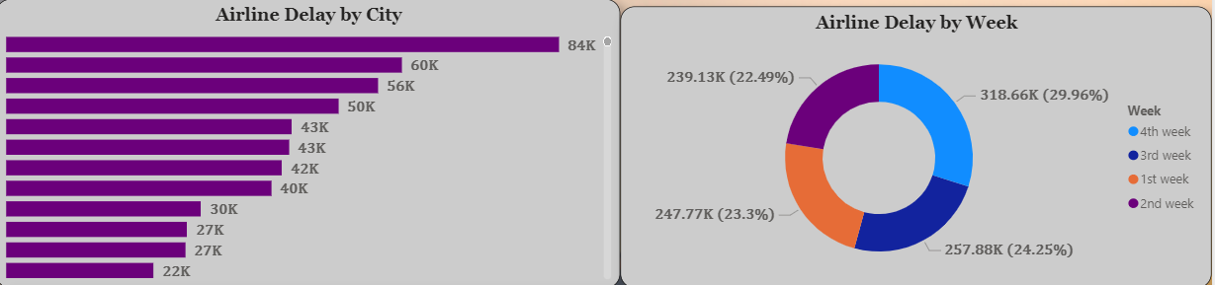
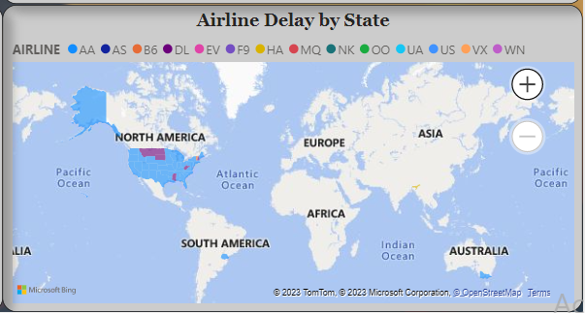
Week wise , state wise and city wise statistics of delay of flights
According to week wise 4th week has highest flights as compare to other weeks with count of 318.66K.
According to city wise Chicago has highest airline delay by 84K and lowest is Portland by 7K.
According to state wise CA has highest airline delay
with American Airlines Inc. compare to other states.

Slide 9
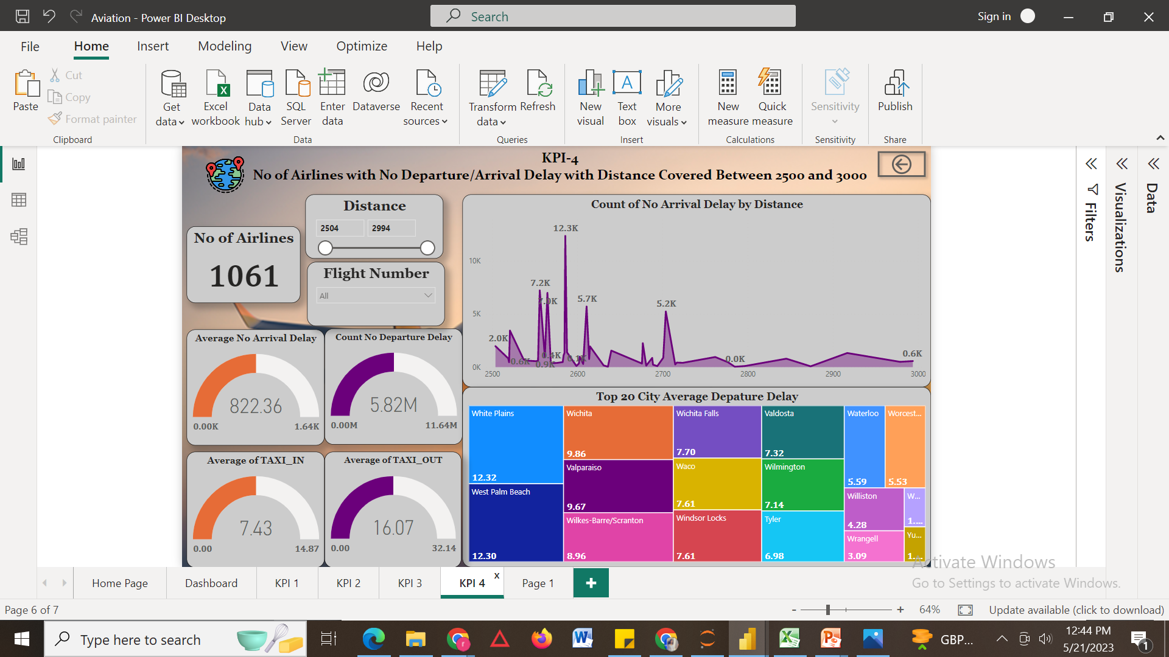
Number of airlines with no departure/ arrival delay
There are 1061 airlines with no departure /no arrival between 2500 and 3000.
Count of highest arrival delay by given distance is 12.3K
Avg/Count of no of Arrival delay and departure delay is 822.36K and 5.82M.

Slide 10
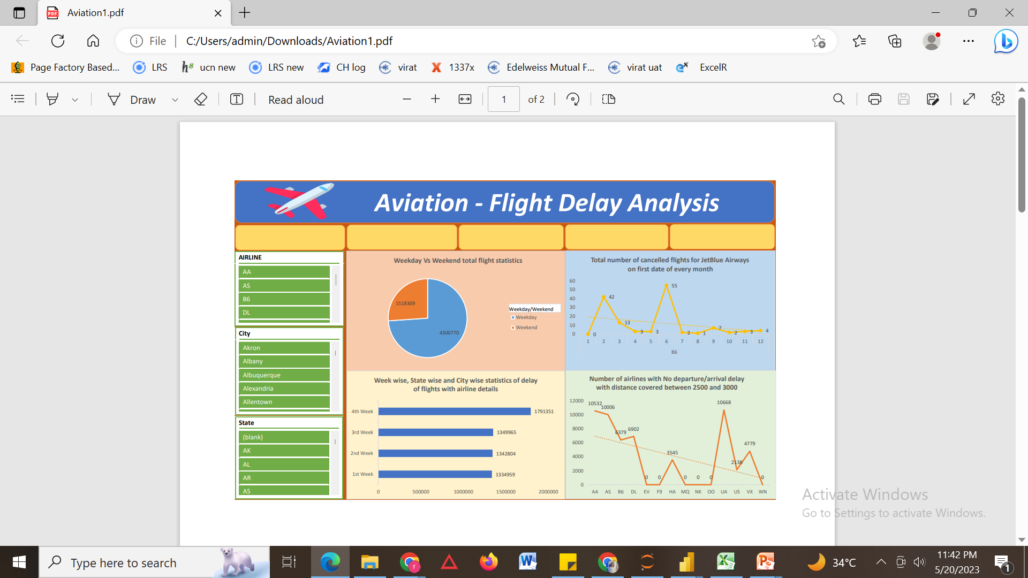
EXCEL DASHBOARD

Slide 11
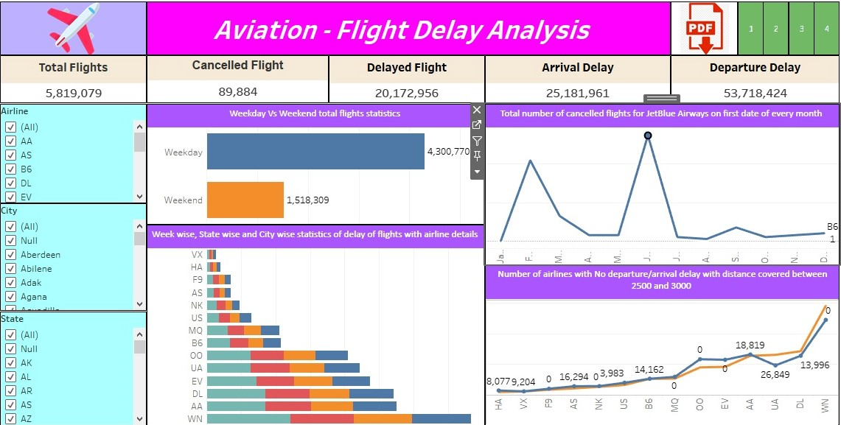
TABLEAU DASHBOARD

Slide 12
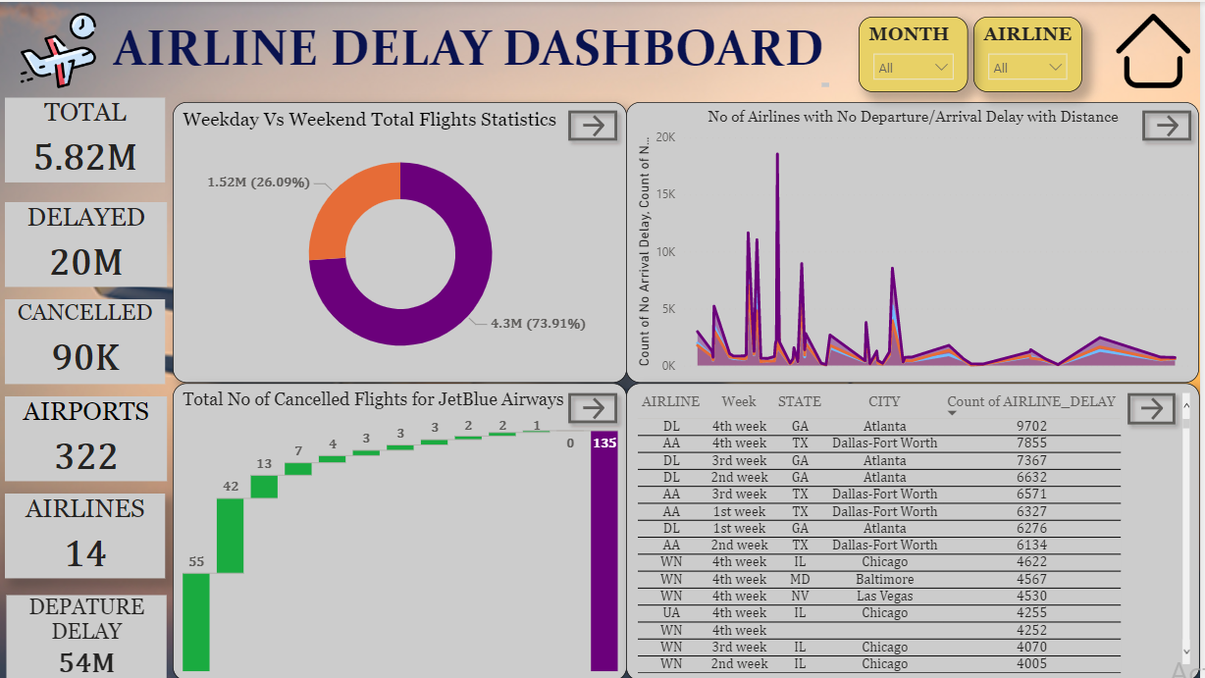
POWER BI DASHBOARD

Slide 13
CONCLUSION
As we can see that weekend has the more flight run than weekdays so that will be more commercial for the airline industries.
By understanding the causes of flight delays, airlines can make informed decisions and implement strategies to minimize disruptions and enhance customer experience. It also provides valuable information for passengers to plan their travel better and manage expectations
The project also highlighted the importance of effective communication between airlines and passengers during delays, as well as the impact of delay flights.

Slide 14
SWOT Analysis
POSITIVE
NEGATIVE
STRENGTH
WEAKNESS
Using Power BI and Tableau was very efficient in generating the required analytics to meet the required KPIs
Using Maps to compare geographical data for better statistics and representation.
Certain regions may have limited airport capacity or outdated facilities, which can pose challenges in terms of scheduling and passenger experience.
INTERNAL
OPPORTUNITY
THREAT
Leveraging new technologies, such as big data analytics, artificial intelligence, and Iot can improve operational efficiency, customer experience, and safety.
Security concerns: Heightened security measures and potential threats to aviation security can disrupt operations and create additional costs for compliance.
Geopolitical factors: Political instability, conflicts, and regulatory changes in different regions can affect international travel and limit market access.
EXTERNAL

Slide 15
Thank You

